Slide 1

Physically Unclonable Function: a Promising Security Primitive for Internet of Things
Debdeep Mukhopadhyay
Secured Embedded Architecture Laboratory (SEAL)
Department of Computer Science and Engineering
Indian Institute of Technology Kharagpur
Kharagpur, West Bengal, INDIA – 721302
E-mail: debdeep.mukhopadhyay@gmail.com

Slide 2

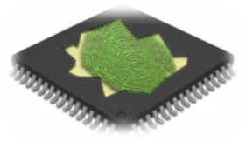
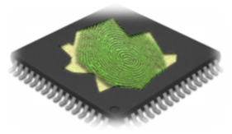

Idea of PUFs
Response3
Challenge
Response1
Response2
The responses have to be unpredictable.
Should not be able to modeled using mathematical analysis.
The responses should also be unique and independent.
That is knowledge of one response, should not leak information of the others!
2

Slide 3
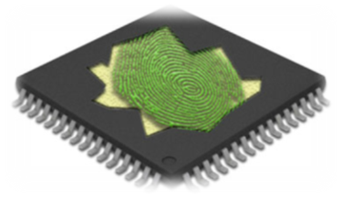
What is a PUF?
Fingerprint of Devices
A challenge-response mechanism in which the mapping between an applied input (“challenge”) and the corresponding observed output (“response”) is dependent on the complex and variable nature of a physical material
The challenge-response mapping is unclonable (ideally) and instance-specific (depends on manufacturing process variations evident in ASICs)
PUF
n-bit Challenge(C)
n-bit Response (R)
3

Slide 4
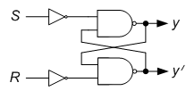
An Example with a simple SR-Latch
in
Make the input in=1, y=1, y’=1.
Make the input in=0, both of the following states are possible:
y=1, y’=0
y=0, y’=1
Source of randomness!
4

Slide 5
From Theory to Practice
FPGAs are ideal for security implementations
In-house and high-performance
Programmability is an added feature
But careful implementation is needed.
module SR(in , Q, Qbar);
input in;
output Q, Qbar;
nand N1(Q, ~in, Qbar);
nand N2(Qbar, ~in, Q);
endmodule
in
Qbar
AND
OR
LUT1
LUT2
Q
The non-determinism and hence the randomness is gone!
5

Slide 6
Another Attempt
module SR(in, Q, Qbar
);
input in;
output Q, Qbar;
(* KEEP = "TRUE" *) wire w1, w2;
nand N1(Q, ~in, w1);
nand N2(Qbar, ~in, w2);
assign w1 = Qbar;
assign w2 = Q;
endmodule
Qbar
in
OR
w1
w2
Q
OR
This design has the non-determinism as expected!
We can also design using NAND primitives.
6

Slide 7
The Silicon Space
Values of Q
Mismatch in driving capabilities of the gates
Difference in routing delays of the feedback path
a Latch cell will give either 0 or 1 as output.
Depends on the (x,y) position of the silicon area.
0
1
1
0
1
(x1,y1)
(x2,y2)
(x3,y3)
(x4,y4)
(x5,y5)
(x6,y6)
(x7,y7)
(x8,y8)
(x9,y9)
(x10,y10)
(x11,y11)
(x12,y12)
(x13,y13)
(x14,y14)
(x15,y15)
(x16,y16)
(x17,y17)
(x18,y18)
(x19,y19)
(x20,y20)
(x21,y21)
(x22,y22)
(x23,y23)
(x24,y24)
(x25,y25)
ICISS 2011
7

Slide 8
Outline
Part-I: PUF Fundamentals
Part-II: Lightweight PUF Design
Part-III: Machine Learning
Part-IV: Authentication Protocols
Reverse Fuzzy Extractor Protocol
Slender PUF Protocols
8

Slide 9
Part I:
PUF Fundamentals
9

Slide 10
Physically Unclonable Function (PUF)?
Fingerprint of Devices
A challenge-response mechanism in which the mapping between an applied input (“challenge”) and the corresponding observed output (“response”) is dependent on the complex and variable nature of a physical material
The challenge-response mapping is unclonable (ideally) and instance-specific
PUF
n-bit Challenge(C)
n-bit Response (R)
10

Slide 11
PUF Properties
Evaluatable: given PUF and x, it is easy to evaluate y = PUF(x).
Unique: PUF(x) contains some information about the identity of the physical entity embedding PUF.
Reproducible: y = PUF(x) is reproducible up to a small error.
Unclonable: given PUF, it is hard to construct a procedure PUF’
up to a small error.
Unpredictable: given only a set, , it is hard to predict y_{c} = PUF(x_{c}) up to a small error, for x_{c} a random challenge such that .
One-way: given only y and the corresponding PUF instance, it is hard to find x such that PUF(x) = y.
Tamper-evident: altering the physical entity embedding PUF transforms PUF →PUF’ such that with high probability
.
11

Slide 12
Quality Metrics for PUF
Uniqueness Reliability
r₁
r₂
r₃
r₁
r₂
r₃
PUF 1
PUF 1
PUF 2
PUF 1
C
C
Devices
Time
PUF 3
PUF 1
Uniformity: ratio of 0’s and 1’s in response
Bit-dependency: autocorrelation coefficient of response
12

Slide 13
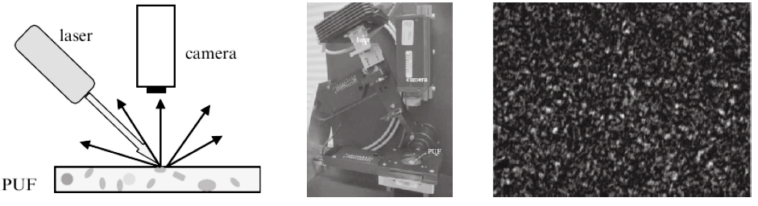
PUF Examples: Optical PUF
Optical PUF was proposed by Pappu et al. with the original name “Physical One-Way Functions (POWFs)”
Made of transparent optical medium containing bubbles. Shining a laser beam through the medium produces a speckle pattern (response) that depends on the exact position/direction of incoming beam
13
Notes:
It is reducing costs and raising security. But, how ? Consider two worlds : 1) Without PUF and 2) with PUF.

Slide 14
Silicon PUFs
We are interested in PUF circuits, i.e. Silicon PUFs
The dominant device for IC design is MOSFET
Silicon PUFs utilize the unavoidable and unpredictable manufacturing process variation effects of modern deep-submicron MOSFET devices
Usually, from CMOS circuit design perspective, process variation is a challenge, but is useful for PUF design
Impact of process variation becomes more pronounced at advanced technology nodes
14
Notes:
It is reducing costs and raising security. But, how ? Consider two worlds : 1) Without PUF and 2) with PUF.

Slide 15
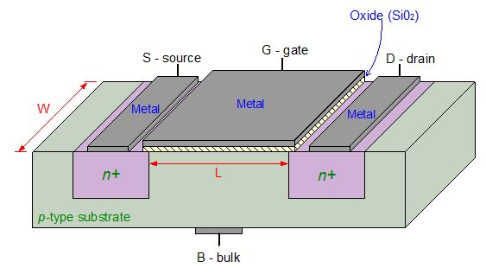
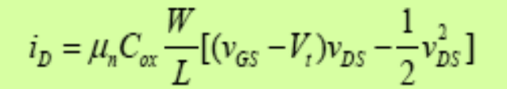
Source of Variations in MOSFETs
Scaling in CMOS deep submicron process technology ( < 100nm channel length)
Lack of efficiency in fabrication process
Introduces variations in MOS device’s physical parameters:
Gate length (L)
Gate width (W)
Threshold Voltage (V_{th})
Oxide thickness (t_{ox})
CMOS scaling → Limitation in fabrication process → Variation in MOS device’s physical parameters → Variation in Circuit parameters (e.g., propagation delay, leakage current, etc) → Existence of randomness
15

Slide 16

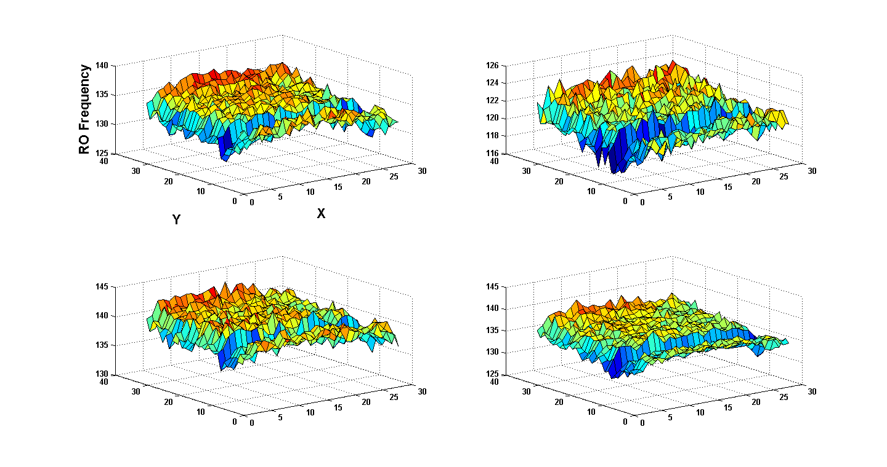
Distinguishable Variations in CMOS Circuit Behavior
Ring Oscillator Oscillating Frequency
FPGA 1
FPGA 2
FPGA 3
FPGA 4
FPGA-specific behavior ➔ FPGA fingerprint
16

Slide 17
Applications of PUF
17

Slide 18


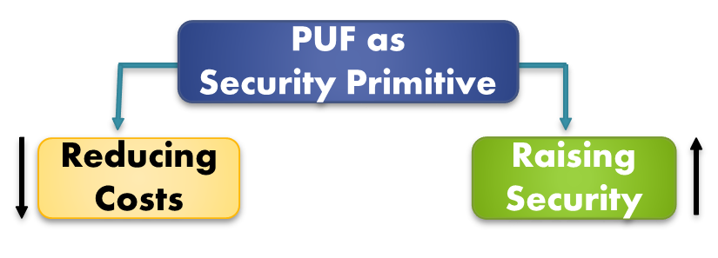
Why are PUFs Important?
Security without PUF
Trusted party embeds and tests secret keys in a secure location (NVM)
EEPROM adds additional complexity to manufacturing
Adversaries may physically extract secret key from non-volatile memory
Security with PUF
Intrinsic properties of device is used to generate secret key.
Key never leaves the IC’s cryptographic boundary, nor be stored in a non-volatile memory.
Key is deleted after usage in de- or encryption process
18
Notes:
It is reducing costs and raising security. But, how ? Consider two worlds : 1) Without PUF and 2) with PUF.

Slide 19



PUF in Use: Low-cost HW Authentication
Protect against IC/FPGA substitution and counterfeits without using cryptographic operations
Untrusted Supply Chain / Environments
Is this the
authentic
Device A?
PUF
PUF
Challenge
Response
Record
Challenge
Response’
Challenge
Response
1010 010101
1000 101101
0111001 000110
=?
Database for Device A
19

Slide 20
PUF in Use: Private/Public Key Pair Generation
Private key
Seed
ECC + PUF
Key
Generation
Public key
PUF response is used as a random seed to a private/ public key generation algorithm
No secret needs to be handled by a manufacturer
A device generates a key pair on-chip, and outputs a public key
The public key can be endorsed at any time
20

Slide 21
Part-II: Lightweight PUF Design
21

Slide 22
Classification of PUF (1/3)
Based on entropy source:
PUFs using explicitly-introduced randomness
Optical PUF
Coating PUF
PUFs using intrinsic randomness
Delay PUF
SRAM PUF
Butterfly PUF
Bistable ring PUF
Magnetic PUF
Metal Based PUF
22

Slide 23
Classification of PUF (2/3)
Based on embedding device Physics:
Optical PUF
Coating PUF
Silicon PUF
Magnetic PUF
Metal Based PUF
Acoustic PUF
23

Slide 24
Classification of PUF (3/3)
Based on security of challenge-response behavior:
Strong PUF
It must have a very large challenge set, since otherwise the adversary can simply query all challenges and no unknown challenges are, and
it is infeasible to built an accurate model of the PUF based on observed challenge-response pairs (CRPs), or in other words the PUF is unpredictable.
Weak PUF
It has small challenge-response set or
Easy to build an accurate model based on observed CRPs.
24

Slide 25
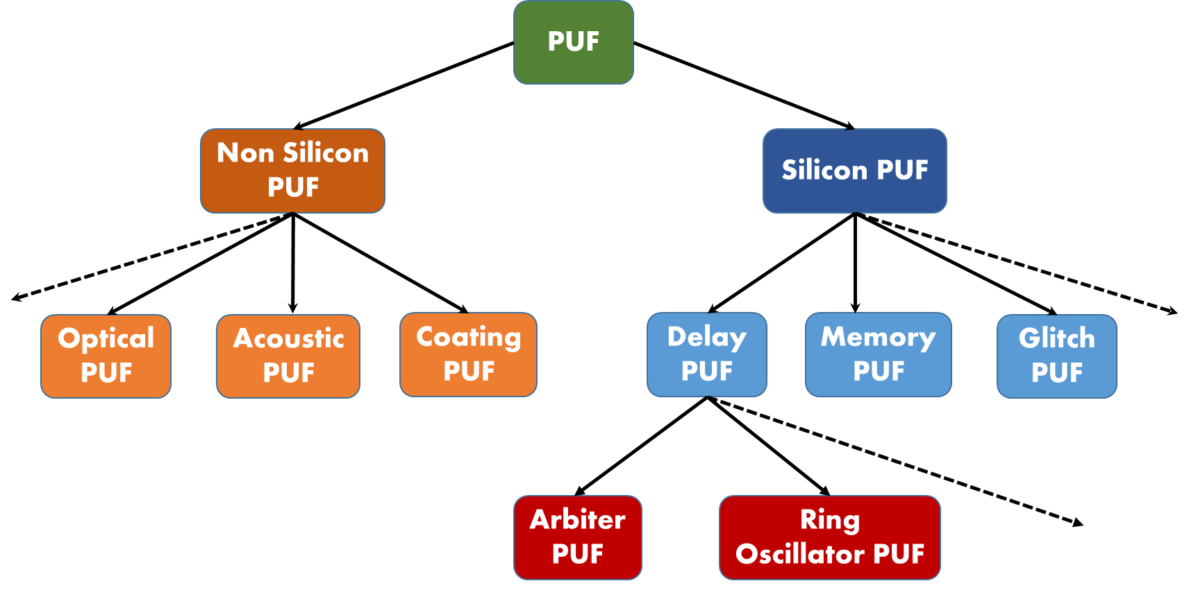
PUF Taxonomy
Lightweight PUFs are composed of different types of PUF building blocks
25

Slide 26
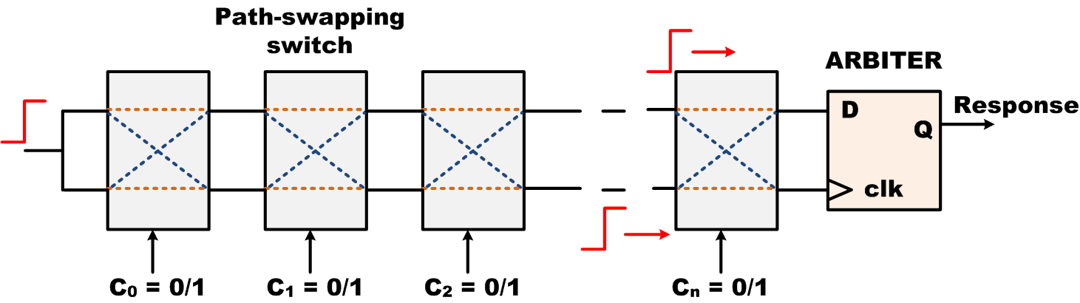
PUF Primitive 1: Arbiter PUF (APUF)
Composed of n two-port switching stages, for an n-bit challenge size
n-bit challenge => 2^{n} possible paths
Unique path selected by a challenge
Accumulated delay at the end of the path is compared by an arbiter circuit (usually, an edge-triggered D flip-flop)
Arbiter gives 1-bit decision
Advantages: Simple structure, low hardware overhead (each stage is two 2:1 MUXes)
Disadvantage: susceptible to modeling attacks
26

Slide 27
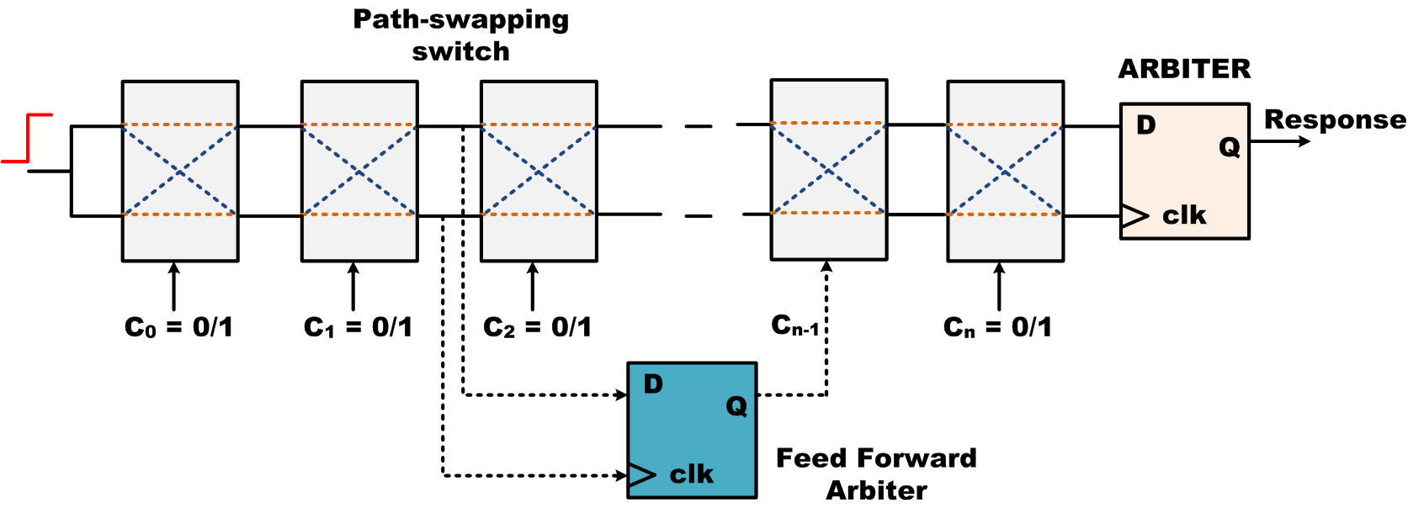
PUF Primitive 2: Feed Forward Arbiter PUF
It is possible to have a linear model for classical Arbiter PUF that results in easy modeling attack on it
Feed Forward Arbiter is used to introduce non-linearity
27

Slide 28
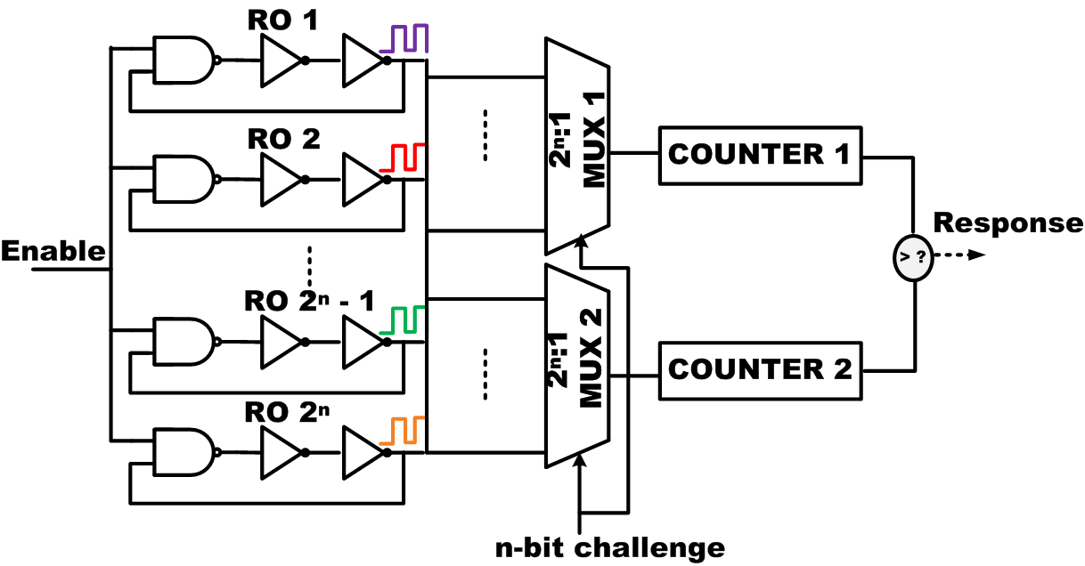
PUF Primitive 3: Ring Oscillator PUF (ROPUF)
An n-bit applied challenge selects two different ROs from a bank of 2^{n} ROs
Process variation implies ROs have different oscillation frequencies
Compare frequencies of two oscillators using counters
Comparator gives decision
Advantage: Difficult to model
Disadvantage: Exponential hardware requirement
28

Slide 29
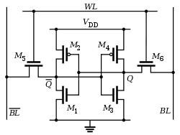
PUF Example 4: SRAM PUF
SRAM PUF cell structure
Power-up initial value of SRAM cell can be used response, cell address is the challenge
SRAM fabrication compatible with digital logic process in regular ICs
FPGA implementation of SRAM PUF is very difficult (since SRAM modules are cleared by default on power-up)
29

Slide 30
Approach 2: Combination of Crypto Primitives and Insecure PUFs
Controlled PUF – Hash PUF [Gassend et al. 2002 ]
N-bit challenges, 1-bit response
N-bit hash functions as input and output networks
N Arbiter PUFs
30

Slide 31
Approach 2: Combination of Crypto Primitives and Insecure PUFs (Contd.)
Lightweight Secure PUF [Majzoobi et al. 2010]
N-bit challenges, k-bit response
Lightweight input and output networks
31

Slide 32
Approach 3: Combination of PUFs
k-XOR PUF [Lee 2005]
N-bit challenges, 1-bit response
k Arbiter PUFs
32

Slide 33
Design 3: Combination of PUFs (Contd.)
Composite PUF [Sahoo et al. 2014]
Multiple levels of PUF primitives are used
N-bit challenges, 1-bit response
33

Slide 34
Part-III: Security Analysis, secure and lightweight PUF-iPUF
34

Slide 35
Security Evaluation of PUF
Unclonability:
- Cannot be achieved using traditional cryptographic techniques
- Two types of unclonability:
- Physical unclonability
- A PUF is physically unclonable if a physical copy of the
PUF with similar challenge/response behaviour cannot
be made, even by the manufacturer (existential
unclonabiliy).
- Mathematical unclonability
- it is not possible to construct a mathematical
approximator which can predict the response
to an arbitrary challenge applied to a given PUF instance,
with a large probability of success
Unpredictability:
- Adversary can’t predict response of a new challenge form a
known set of CRPs
Notes:
It is reducing costs and raising security. But, how ? Consider two worlds : 1) Without PUF and 2) with PUF.

Slide 36

PUF Attack Overview
Mathematical Clone
Physical
Clone
Contactless Probing
Mechanical Probing
Side channel Probing
Four paths leading to a PUF cloning attack
Creating a physical clone of the PUF is considered infeasible
The creation of a mathematical clone requires that the raw PUF response(s)
Non-invasive attack methods using side channel analysis on the PUF
Invasive attack involving mechanical probing of r’
Attackers with access to contactless probing equipment can use a semi-invasive methodology to obtain the data of interest
Notes:
It is reducing costs and raising security. But, how ? Consider two worlds : 1) Without PUF and 2) with PUF.

Slide 37
PUF Attacks
Brute Force:
To save every Challenge Response Pairs (CRPs)
Physical Access to PUF is required
Replay Attack:
Eavesdropping CRPs and play them back
Modelling Attack (or Machine Learning Attack):
Take the advantage between relationship between challenge the challenge/response
Build a PUF model using Machine Learning (ML) methods:
- Support Vector Machine (SVM)
- Artificial Neural Network (ANN)
- Logistic Regression (LR)
- Evolution Computing
Set of CRPs needed to train ML algorithm
Notes:
It is reducing costs and raising security. But, how ? Consider two worlds : 1) Without PUF and 2) with PUF.

Slide 38
Security Notion
A PUF P with n-bit challenge and m-bit response is considered as secure if it satisfies the following conditions:
No algorithm to predict the response R produced by an arbitrary PUF instance when an arbitrary challenge with probability of success greater than 2^{-m}
No algorithm to predict the response R for an arbitrary challenge with high probability of success, with sub-exponential time and space complexity
No algorithm to predict the response R for an arbitrary challenge with high probability of success, with sub-exponential data complexity. “Data” in this context is the challenge-response pair (CRP) database
38

Slide 39
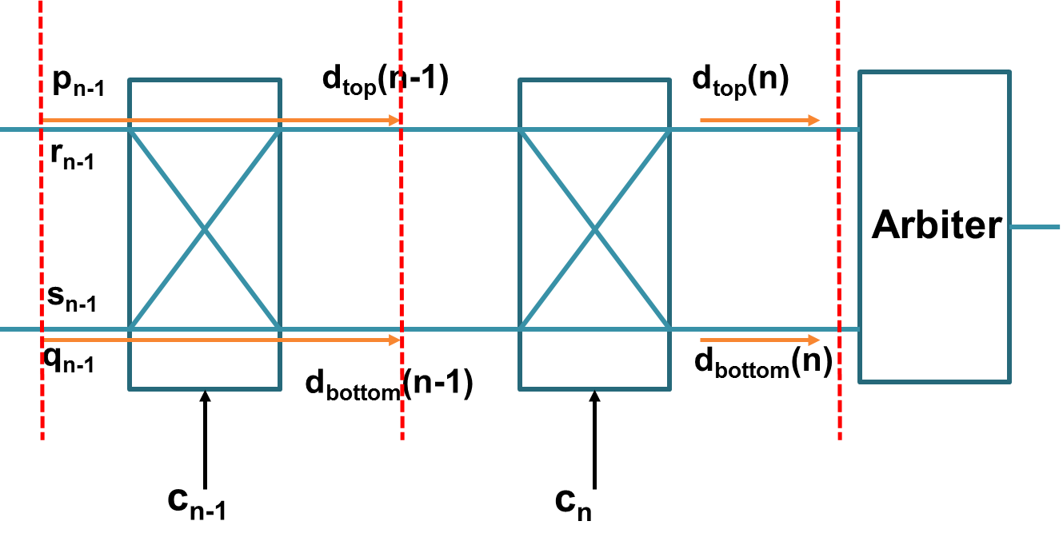
Linear Delay Model of Arbiter PUF [D. Lim, M.S. Thesis, MIT, 2002]
denotes the challenge bit of the i-th stage
Notes:
It is reducing costs and raising security. But, how ? Consider two worlds : 1) Without PUF and 2) with PUF.

Slide 40
Linear Delay Model of Arbiter PUF (contd.)
Notes:
It is reducing costs and raising security. But, how ? Consider two worlds : 1) Without PUF and 2) with PUF.

Slide 41
ICISS 2011
41

Slide 42
Linear Delay Model of Arbiter PUF
Let p_{k} be the parity of challenge bits:
where
An Arbiter PUF is a linear classifier of random challenge vectors in n-dimensional space, where n is the total number of challenge bits
Apply Support Vector Machine (SVM) using:
Parity vectors X are n-dimensional feature vectors
Constant vector d is the normal to the hyperplane that classifies challenges into two classes
Notes:
It is reducing costs and raising security. But, how ? Consider two worlds : 1) Without PUF and 2) with PUF.

Slide 43
Reported Modeling Attack Results
Modeling Attacks by Machine Learning (Rührmair et al.)
Logistic Regression success rate
Arbiter
99.9% using 18K CRPs in 0.6 sec. (64 taps)
XOR Arbiter
99% using 12K CRPs in 3 min 42 secs (4 XOR, 64 taps).
Lightweight Arbiters
99% using 12K CRPs in 1 hour and 28 mins (4 XORs, 64 taps).
Feed-forward Arbiters
99% using 5K CRPs in 47 mins and 7 secs (7 FF, 64 taps).
Notes:
It is reducing costs and raising security. But, how ? Consider two worlds : 1) Without PUF and 2) with PUF.

Slide 44
Reported Modeling Attack Results (contd.)
[D. Lim, M.S. Thesis, MIT, 2002]
Worked on computer simulation model of Arbiter PUF
Claimed 100% modeling accuracy by applying SVM (PUF size and training set size not mentioned)
[Maes et al, IEEE WIFS’12]
Silicon (ASIC) data
ASIC fabricated in 65 nm CMOS technology
64-bit Arbiter PUF
500 CRPs as training set
Claims ~90% prediction accuracy using SVM
[CSE Dept., IIT-KGP]
Silicon (FPGA Data)
64-bit Arbiter PUF
5000 CRPs as training set
~96% prediction accuracy using SVM
Notes:
It is reducing costs and raising security. But, how ? Consider two worlds : 1) Without PUF and 2) with PUF.

Slide 45
Part IV:
PUF-based Authentication Protocols
45

Slide 46
Protocols
We consider the following authentication protocols:
Naïve authentication
Reverse Fuzzy Extractor Authentication
Slender PUF Protocol
46

Slide 47
Authentication Protocol
Authentication Protocol is a process with can allow two parties to authenticate to each others.
The protocols are based on the following things
What do you know: password, secret key
What do you have: token, identity card
Who are you: bio-authentication, your finger print etc.
47

Slide 48
Naïve Authentication
48

Slide 49
Naïve Authentication
Limitations:
The bare CRPs are used.
If adversary can collect the CRPs, then she can imitate a legal client.
49

Slide 50
Reverse Fuzzy Extractor Protocol
The helper data concept is used.
R is reference response
Helper data h=Gen(R).
For a noisy response R’, we have R=Reprod(h,R’).
Gen is not an expensive operation
Reprod is an expensive operation
50

Slide 51
Reverse Fuzzy Extractor Protocol (contd.)
51

Slide 52
Slender PUF Protocol
A model of weak PUF is made and the host keeps it
The information of CRP is hidden
52

Slide 53
Slender PUF Protocol (contd.)
53

Slide 54
Slender PUF Protocol
New contribution:
Instead of storing CRPs, we use a WEAK PUF which we can model. However, the security of this protocol is still not clear.
54

Slide 55
References
Daihyun Lim. Extracting Secret Keys from Integrated Circuits. Master's thesis,MIT, USA, 2004
Ahmed Mahmoud, Ulrich Ruhrmair, Mehrdad Majzoobi, and Farinaz Koushanfar. Combined Modeling and Side Channel Attacks on Strong PUFs. IACR Cryptology ePrint Archive, 2013:632, 2013.
Mehrdad Majzoobi, Farinaz Koushanfar, and Miodrag Potkonjak. Lightweight secure PUFs. In Proc. of the 2008 IEEE/ACM International Conference on Computer-Aided Design(ICCAD), pages 670{673, Piscataway, NJ, USA, 2008. IEEE Press
Stefan Mangard, Elisabeth Oswald, and Thomas Popp. Power analysis attacks revealing the secrets of smart cards. Springer, 2007.
Durga Prasad Sahoo, Phuong Ha Nguyen, Debdeep Mukhopadhyay, and Rajat Subhra Chakraborty. A Case of Lighweight PUF Constructions: Cryptanalysis and Machine Learning Attacks. 2014. under submission.
Durga Prasad Sahoo, Sayandeep Saha, Debdeep Mukhopadhyay, Rajat Subhra Chakraborty, and Hitesh Kapoor. Composite PUF: A New Design Paradigm for Physically Unclonable Functions on FPGA. In IEEE International Symposium on Hardware-Oriented Security and Trust (HOST), 2014.
55

Slide 56
References (contd.)
Ulrich Ruhrmair, Frank Sehnke, Jan Solter, Gideon Dror, Srinivas Devadas, and Jurgen Schmidhuber. Modeling attacks on physical unclonable functions. In Proc. of 17th ACM conference on Computer and communications security(CCS), pages 237{249, New York, NY, USA, 2010. ACM.
A. Herrewege, S. Katzenbeisser, R. Maes, R. Peeters, A.-R.Sadeghi, I. Verbauwhede, and C. Wachsmann. Reverse fuzzy extractors: Enabling lightweight mutual authentication for pufenabled rfids. In Financial Cryptography and Data Security, volume 7397 of Lecture Notes in Computer Science, pages 374–389. Springer Berlin Heidelberg, 2012..
M. Majzoobi, M. Rostami, F. Koushanfar, D. Wallach, and S. Devadas. Slender puf protocol: A lightweight, robust, and secure authentication by substring matching. In Security and Privacy Workshops (SPW), 2012 IEEE Symposium on, pages 33–44, May 2012.
Blaise Gassend, Dwaine Clarke, Marten van Dijk, and Srinivas Devadas. Controlled Physical Random Functions. In Proc. of 18th Annual Computer Security Applications Conference( ACSAC ), page 149, Washington, DC, USA, 2002. IEEE Computer Society.
56

Slide 57
Part V:
Demonstration – Arbiter PUF
on Xilinx Artix-7 FPGA
57

Slide 58

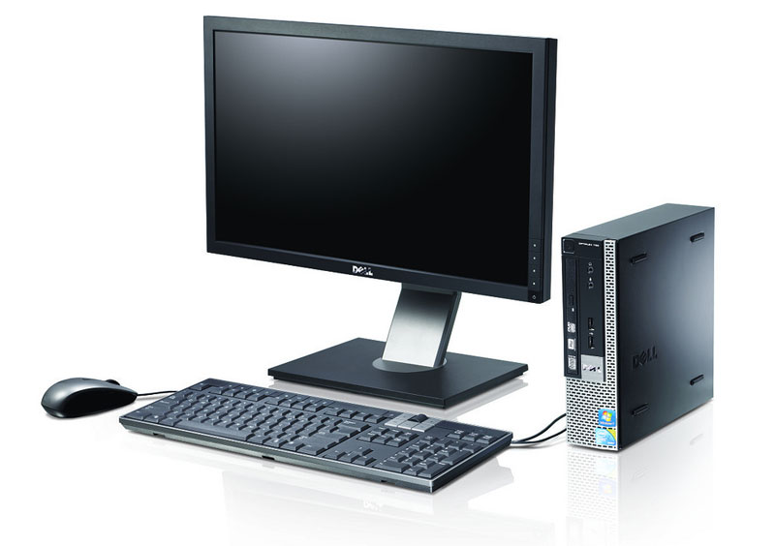

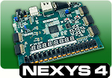
PUF Lab Setup
58

Slide 59
Arbiter PUF
Composed of n two-port switching stages, for an n-bit challenge size
n-bit challenge => 2^{n} possible paths
Unique path selected by a challenge
Arbiter gives 1-bit decision
Advantages: Simple structure, low hardware overhead (each stage is designed two 2:1 MUXes)
59

Slide 60
Design Overview
FPGA
PicoBlaze Microcontroller
PC
128-bit
Arbiter PUF
controls
challenge
challenge
response
response
60

Slide 61
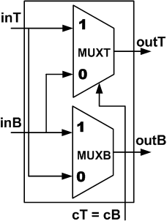
Switch Design
switch_2to2 (inT, inB, cT,cB, outT, outB);
input inT; // Upper input signal
input inB; // lower input signal
input cT; // Control input
input cB; // Control input
output outT; // Upper output signal
output outB; // Lower output signal
(*LOCK_PINS = "all"*)
mux_21 MUXT(
.ins({inB,inT}),
.ctrls(cT),
.out(outT)
);
(*LOCK_PINS = "all"*)
mux_21 MUXB(
.ins({inT,inB}),
.ctrls(cB),
.out(outB)
);
endmodule
61

Slide 62
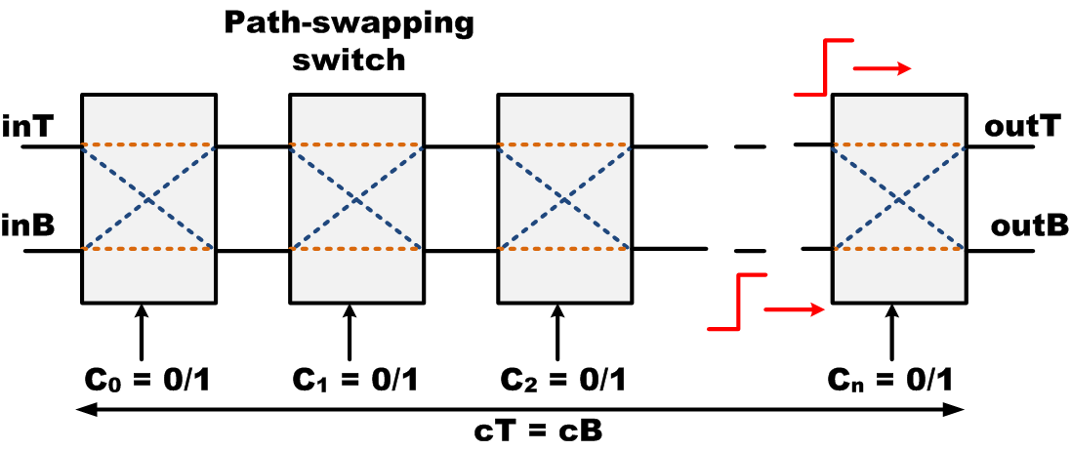
Parallel Paths
module switchChain #( parameter nStage = 16)( inT, inB, cT, cB, outT, outB );
input inT,inB;
input [nStage-1:0] cT, cB;
output outT, outB;
wire [nStage:0] netT;
wire [nStage:0] netB;
assign outT = netT[nStage]; // Output signal from upper and lower paths
assign outB = netB[nStage];
assign netT[0] = inT; // Input trigger signal for puf
assign netB[0] = inB;
// Generate chain of switches
genvar i;
generate
for(i = 0; i < nStage; i = i + 1) begin:STAGE
(*KEEP_HIERARCHY = "TRUE"*)
switch_2to2 SW (
.inT(netT[i]),
.inB(netB[i]),
.cT(cT[i]),
.cB(cB[i]),
.outT(netT[i+1]),
.outB(netB[i+1])
);
end
endgenerate
endmodule
62

Slide 63





Arbiter
module arbiter (clk,din,dout);
input clk;
input din;
output reg dout;
always @(posedge clk) begin
dout <= din;
end
endmodule
D
1
clk
D
0
clk
Arbiter Operation
63

Slide 64
APUF Design
module apufClassic #(parameter nStage = 128)( clk, tigSignal, c,respReady,respBit);
input clk, tigSignal;
input [nStage-1:0] c; // Challenge for upper and lower paths
output respReady, respBit;
wire pathT;
wire pathB;
reg tigReg;
assign respReady = (pathT & pathB); // status of response
always@(posedge clk) // to reduce the bias in trigger signal
tigReg <= tigSignal;
// Chain of switches
(*KEEP_HIERARCHY = "TRUE"*)
switchChain #(.nStage(nStage) ) SWITCH_CHAIN(
.inT(tigReg),
.inB(tigReg),
.cT(c),
.cB(c),
.outT(pathT), // to arbiter
.outB(pathB) // to arbiter
);
// Arbiter
arbiter A(
.din(pathT),
.clk(pathB),
.dout(respBit)
);
endmodule
64

Slide 65
Ideal Arbiter PUF
Path-pair selected by a challenge should symmetric
Nominal delay difference should be 0
It is difficult to achieve in FPGA
But, we can reduce delay bias by manual placement of Switches and Arbiter
65

Slide 66
Placement of 128-bit APUF
INST "APUF/SWITCH_CHAIN/STAGE[0].SW/MUXU/Mmux_out11" BEL = A6LUT;
INST "APUF/SWITCH_CHAIN/STAGE[0].SW/MUXL/Mmux_out11" BEL = B6LUT;
INST "APUF/SWITCH_CHAIN/STAGE[0].SW/MUXU/Mmux_out11" LOC = SLICE_X2Y2;
INST "APUF/SWITCH_CHAIN/STAGE[0].SW/MUXL/Mmux_out11" LOC = SLICE_X2Y2;
INST "APUF/SWITCH_CHAIN/STAGE[1].SW/MUXU/Mmux_out11" BEL = A6LUT;
INST "APUF/SWITCH_CHAIN/STAGE[1].SW/MUXL/Mmux_out11" BEL = B6LUT;
INST "APUF/SWITCH_CHAIN/STAGE[1].SW/MUXU/Mmux_out11" LOC = SLICE_X2Y3;
INST "APUF/SWITCH_CHAIN/STAGE[1].SW/MUXL/Mmux_out11" LOC = SLICE_X2Y3;
INST "APUF/SWITCH_CHAIN/STAGE[127].SW/MUXU/Mmux_out11" BEL = A6LUT;
INST "APUF/SWITCH_CHAIN/STAGE[127].SW/MUXL/Mmux_out11" BEL = B6LUT;
INST "APUF/SWITCH_CHAIN/STAGE[127].SW/MUXU/Mmux_out11" LOC = SLICE_X2Y129;
INST "APUF/SWITCH_CHAIN/STAGE[127].SW/MUXL/Mmux_out11" LOC = SLICE_X2Y129;
INST "APUF/tigReg" BEL = AFF;
INST "APUF/tigReg" LOC = SLICE_X2Y1;
INST "APUF/tigSignal_inv1_INV_0" BEL = B6LUT;
INST "APUF/tigSignal_inv1_INV_0" LOC = SLICE_X3Y1;
INST "APUF/ARBITER/dout" BEL = BFF;
INST "APUF/ARBITER/dout" LOC = SLICE_X1Y130;
INST "APUF/respReady1" BEL = A6LUT;
INST "APUF/respReady1" LOC = SLICE_X1Y130;
66

Slide 67
Thank You for Your Attention!
67

